Slide 1

Machine learning on Chicago Crime Dataset Final Project Proposal Advance Data Science & architecture
Team9:
- Aashri Tandon
- Pragati Shaw
- Sarthak Agarwal

Slide 2
Introduction to data
The main idea behind this project is to perform geospatial analytics and machine learning on Chicago Crime dataset.
This dataset reflects reported incidents of crime (with the exception of murders where data exists for each victim) that occurred in the City of Chicago from 2001 to present. Data is extracted from the Chicago Police Department's CLEAR (Citizen Law Enforcement Analysis and Reporting) system from the below URL.
https://data.cityofchicago.org/Public-Safety/Crimes-2001-to-present/ijzp-q8t2/data
Dataset Size: 1.4 Gigabytes
No. of records: ~6.3 million
No of columns: 22

Slide 3
Diving Deep into the features
Columns
ID | Unique identifier for the record.
Case Number | Chicago Police Department RD Number (Records Division Number)
Date | Date when the incident occurred
Block | The partially redacted address where the incident occurred, placing it on the same block as the actual address
IUCR | The Illinois Uniform Crime Reporting code
Primary Type | The primary description of the IUCR code.
Description | The secondary description of the IUCR code, a subcategory of the primary description.
Location Description | Description of the location where the incident occurred.
Arrest | Indicates whether an arrest was made.
Domestic | Indicates whether the incident was domestic-related
Beat | A beat is the smallest police geographic area
District | Indicates the police district where the incident occurred
Ward | The ward (City Council district) where the incident occurred
Community Area | Indicates the community area where the incident occurred.
FBI Code | Indicates the crime classification as outlined in the FBI's National Incident-Based Reporting System
X Coordinate | The x coordinate of the location where the incident occurred
Y Coordinate | The y coordinate of the location where the incident occurred
Year | Year the incident occurred.
Updated On | Date and time the record was last updated.
Latitude | The latitude of the location where the incident occurred.
Longitude | The longitude of the location where the incident occurred.
Location | The location where the incident occurred

Slide 4
Problem Statement
Our goal is to create a web application that would give insights to its user about the crime scenario and its various aspects in Chicago.
Our application will contain:
A search box/drop down list where user can select a district.
Geospatial analysis using ArcGIS maps and visualizations that are embedded into the web app which will be dynamically updated to show most interesting patterns or heat maps for that district.
Statistical analysis and visualizations on historical data to the user.
Prediction of the date when the next crime will happen and its probability.

Slide 5
Part1: Data Download & Preprocessing
Data Download
Write a python script that automatically downloads the data from the website to a particular location. https://data.cityofchicago.org/Public-Safety/Crimes-2001-to-present/ijzp-q8t2/data
Handle Missing Values
Check the percentage of missing values and their frequency distribution. Then choose appropriate technique to handle missing data.
Feature Engineering.
Check for data correlation and eliminate or create new features as needed. These features will be selected keeping in mind the machine learning component of the application.

Slide 6
Part2: Geospatial Analysis
Setup ArcGIS account and integrate ArcPy which is a ArcGIS Python site package that provides a useful and productive way to perform geographic data analysis, data conversion, data management, and map automation with Python.
Load the data into ArcGIS and write scripts that are most interesting to the end user.
Some of the initial ideas are as follows, but they are subject to change as we play more with the data and ArcGIS.
What are the effects that a district with high criminal activity has on its neighbors.
From 2001 to 2017, how the crime has spread and what are its affects on the demographics.
Hot Spot Analysis of events or incidents.

Slide 7
Part3: Data Visualization
Exploratory data analysis will serve two purpose. Firstly, we will learn insights about the data and secondly we will display the best analysis that will be beneficial to our end user in the web application.
We will do the following types of analysis:
Perform univariate and bivariate data analysis to get insights about the data.
Plot data visualization. E.g.
How has crime changed over the years?
Which areas have evolved over the time span of 2001 to 2017?

Slide 8
Part 4: Machine Learning
The machine learning engine in our application will have two parts:
Clustering: We will divide the regions in Chicago into different clusters based on districts. It will result in 20 clusters.
Prediction: We will then build prediction models for each cluster that will predict the date when the next crime will happen and its probability.
We will try different models like Linear Regression, Random forest and SVM and will choose the best prediction model.
The final model will be deployed in Azure and a REST API will be created to be called from the web application.

Slide 9
System Architecture
Docker
Data loading, pre-processing will happen in Docker image
S3
Cleaned files will be loaded to S3.
Azure ML Studio
ArcGIS
Cleaned files will be used to build ML models and ArcGIS visualization.
Rest API
Rest APIs will be created for ML model and ArcGIS and called into the web application.
Web Application

Slide 10
Tools
Python – Data processing and Machine Learning.
Docker – For easy distribution and submission.
Java – Web application.
Microsoft Azure ML Studio – Machine learning Rest API
ArcGIS – Geospatial analysis

Slide 11
Mockup

Slide 12
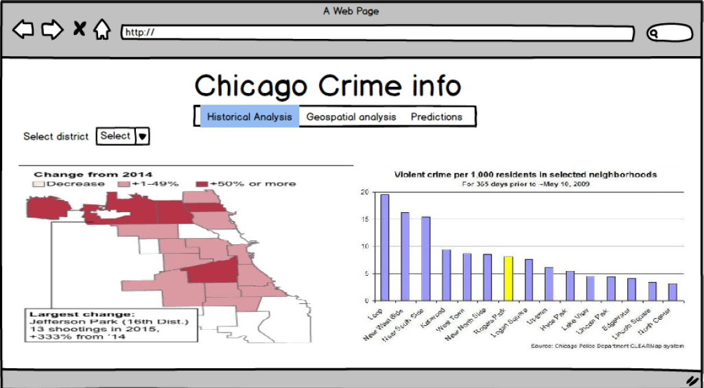

Slide 13
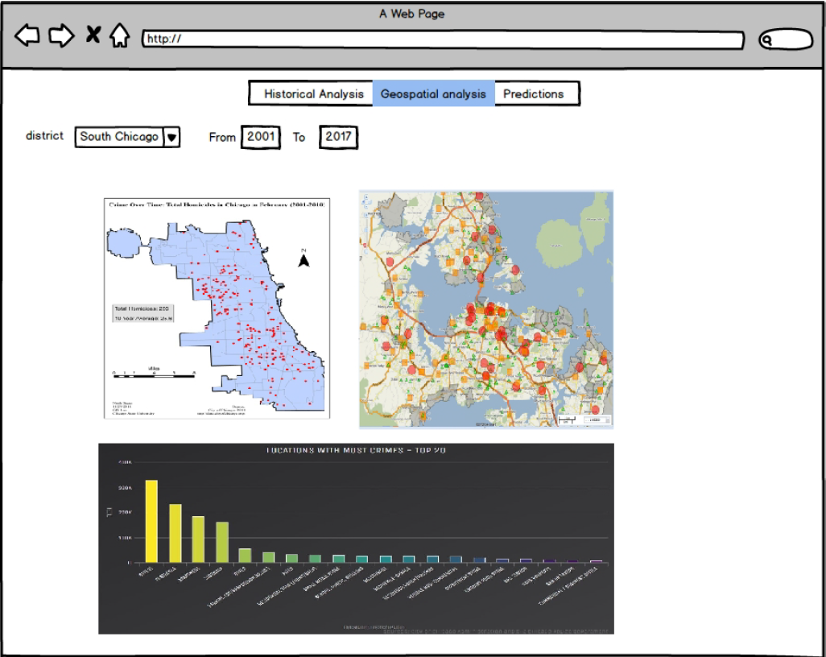

Slide 14
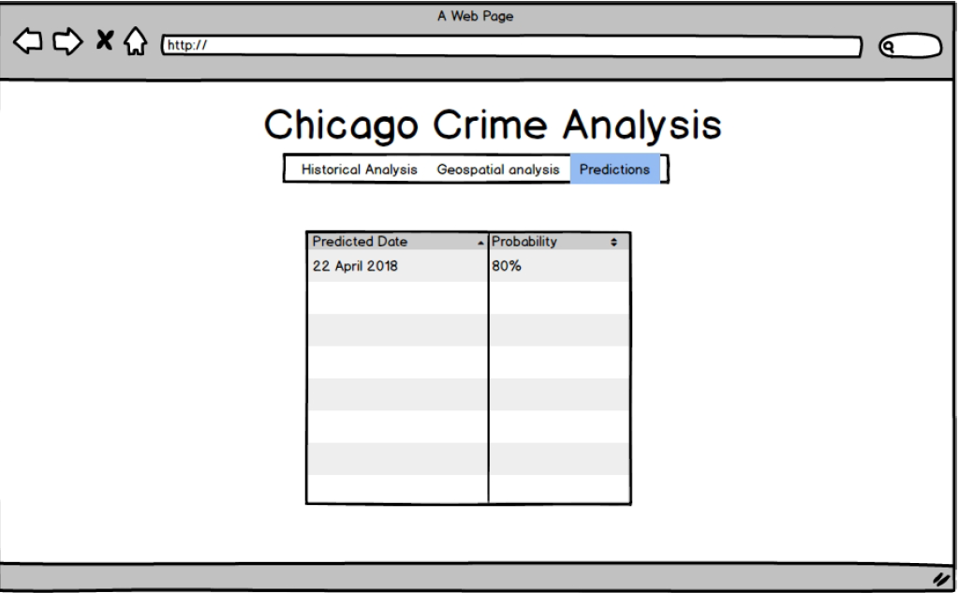

Slide 15
Thank You!

